Slide 1


Find the Outliers of the “Time” Data Array of Neutron Star SGR 0501+4516
Alex Wei

Slide 2
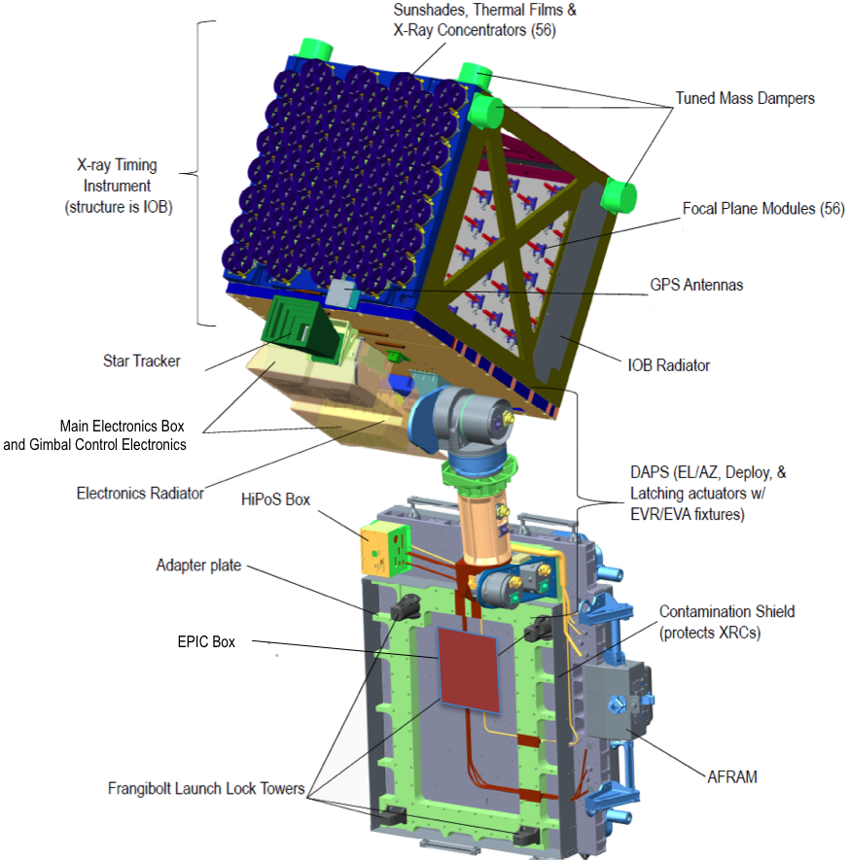

Where Does the Data From?
Neutron star Interior Composition Explorer (NICER)
56 X-ray photon telescopes. Observe mainly about the rotating neutron stars, pulsars.
Size -> radius -> the core density -> apply constrain nuclear theories -> describe how the particles at neutron star core interact with each other.
A pulsar is a highly magnetized rotating neutron star or white dwarf that emits a beam of electromagnetic radiation.

Slide 3
Data of What?
Neutron Star SGR 0501+4516 is a magnetar that was discovered in 2008 during an outburst, which has recently returned to quiescence.
A magnetar is a type of neutron star believed to have an extremely powerful magnetic field. The magnetic field decay powers the emission of high-energy electromagnetic radiation, particularly X-rays and gamma rays.
It is located approximately 15,000 light years from Earth and has a magnetic field 100 trillion times stronger than the Earth’s.
Significance: It has been the first SGR to have been discovered after ten years without SGR detections.
SGR: soft gamma repeater: an astronomical object which emits large bursts of gamma-rays and X-rays at irregular intervals.

Slide 4

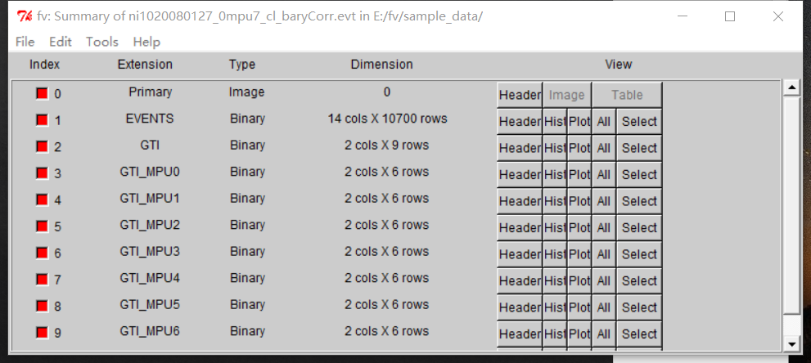
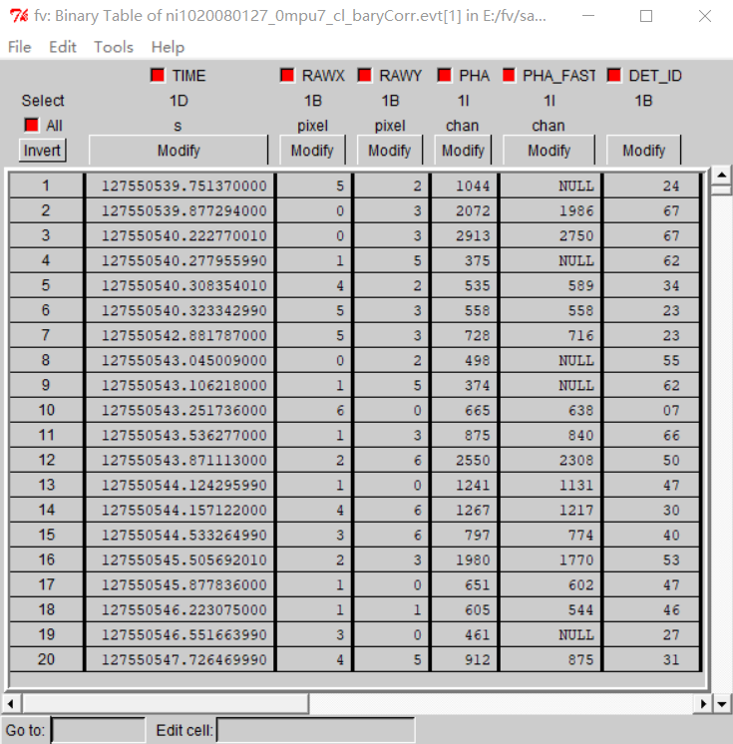
First Thing Is To Examine the Data
We use the FitsViewer (fv) to look at the data and choose the “Time” column for further analysis.
Now we are trying to convert the raw data file (.evt) into a standard excel file (.csv) for further analysis using python.

Slide 5
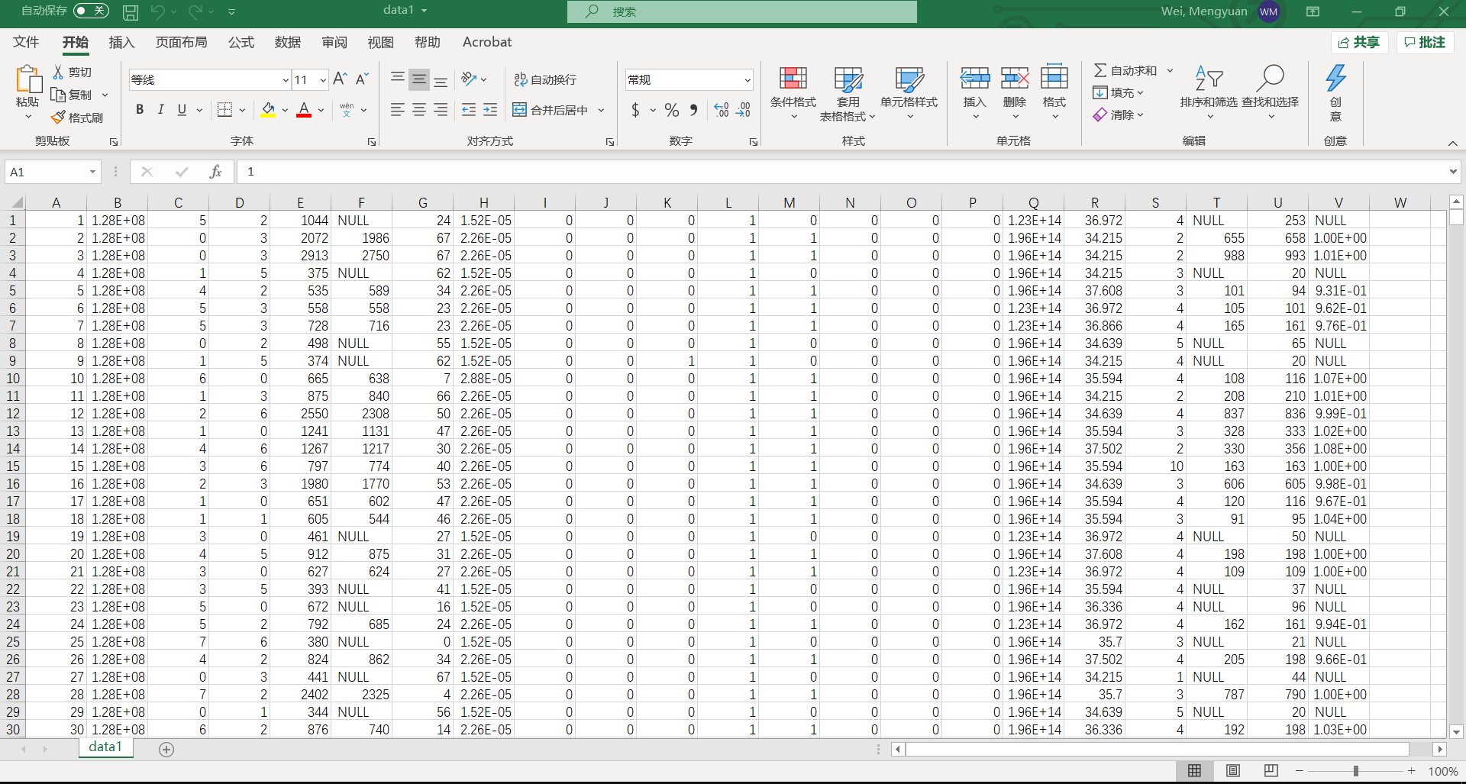
Conversion of Original File to Excel File
Use the FitsViewer to open the original data file (.evt) and display the data set.
Then choose to export the original data to text file, and then we change the file suffix name ".txt" to ".csv".
Rename the csv file as "data1.csv" under the folder of the desktop.

Slide 6
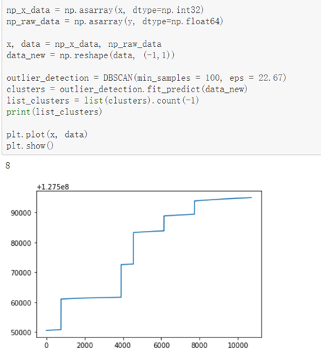
First Plot of the raw Data Array “Time”
Now Plot the “Time” array to see the pattern of the raw data array “Time”.
We use x and y axis to plot the “Time” data array. In this plot, x stands for the row number, from 1 to 10700. And y stands for the raw data array, corresponds to its row number.
We use db scan here to detect clusters. And then plot these clusters.
There are 5 break points in the original data array, “Time”, and we need to find these breakpoints.

Slide 7
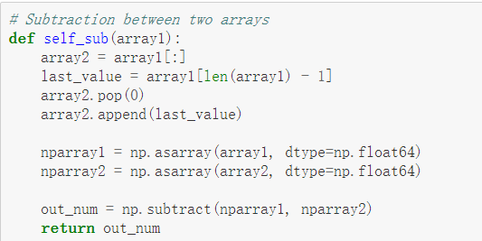
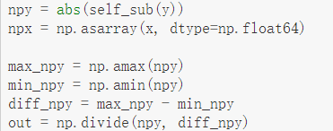
The Subtraction of Two Arrays to Get npy
First, we convert the list to numpy arrays. Convert x to npx.
Instead of converting the y to npy, we use the subtraction of two arrays, get the new array named "out".

Slide 8
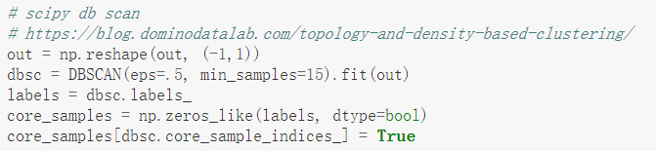
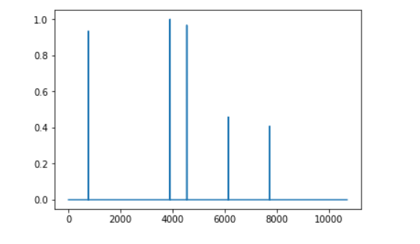
Scipy db Scan to Plot Again
Here we use the Scipy library to use db scan again to plot the data array “Time” using numpy converted arrays.
Here we know we have 5 outliers to find.

Slide 9
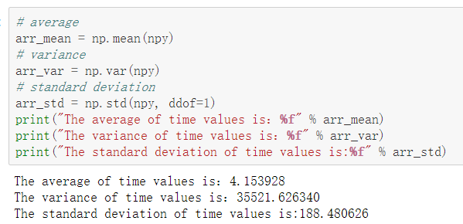
Getting better Acknowledge of Our Data
Here We know from the calculated average, variance and standard deviation that the data should be in a skew-right distribution.
From here, we should use methods to find the outliers.

Slide 10
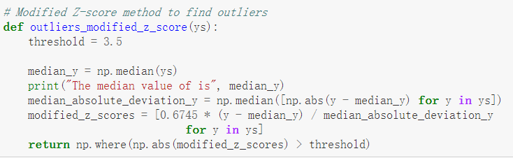
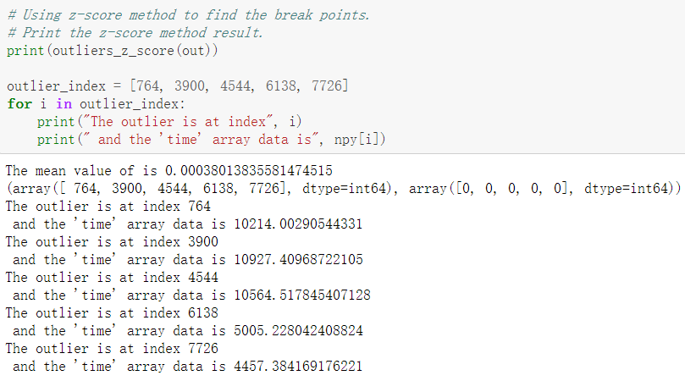
Find Out the Outliers of the Data Array “Time”
The Outliers could be found using the z-score method.
We also use other ways to identify outliers. However, the methods don’t give what we see in the previous plot.
Other methods could be found here: https://towardsdatascience.com/5-ways-to-detect-outliers-that-every-data-scientist-should-know-python-code-70a54335a623

Slide 11
Resources
NICER Pictures. Retrieved from https://www.nasa.gov/mission_pages/station/research/experiments/explorer/Investigation.html#id=1705.
My own project HTML page. file:///C:/Users/GE63VR/Desktop/ASTR3141%20Final%20Project/ASTR3141%20Project%20Report%20(contain%20codes).html

